Slide 1
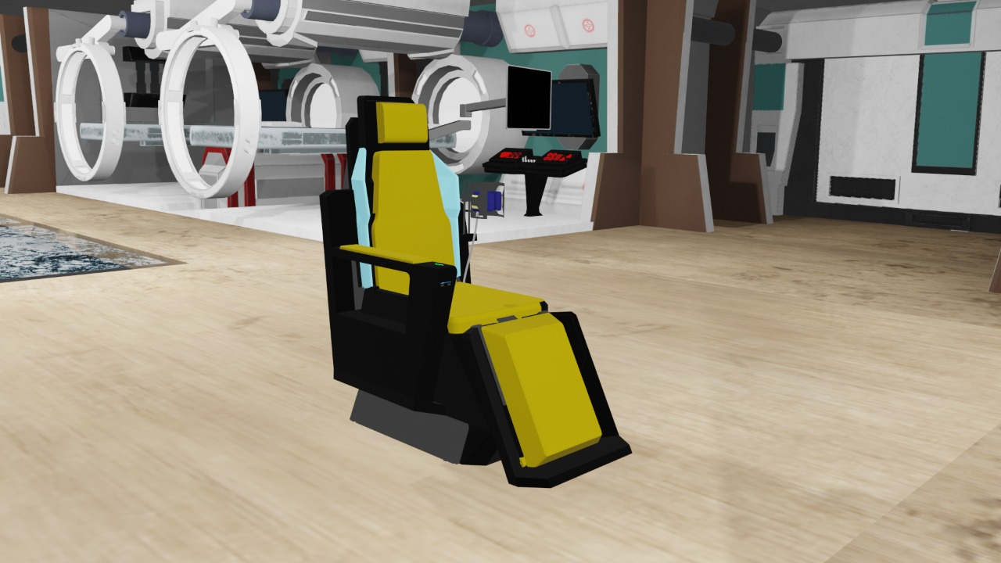
Static testing chair
Team Size : Four
Mentors : Self
College : Manakula Vinayagar Institute of Technology
Type : Private
Team Name:
Future Innovators

Slide 2
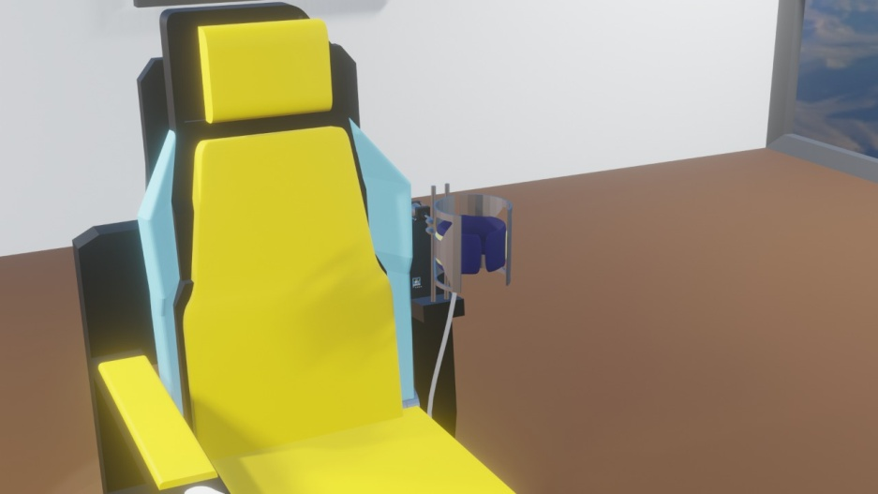
Team Details:
1)PRAVEEN D dkpraveen111102@gmail.com
7339008449.
2)MAHALAKSHIMI V Mahakriti2003@gmail.com 9488119412
3) SRINATH G srinath8116@gmail.com 9345331785
4) kRISHA B krishababu25@gmail.com
9159690016
TEAM OBJECTIVE :
To measure the human data in a fraction of minutes.

Slide 3
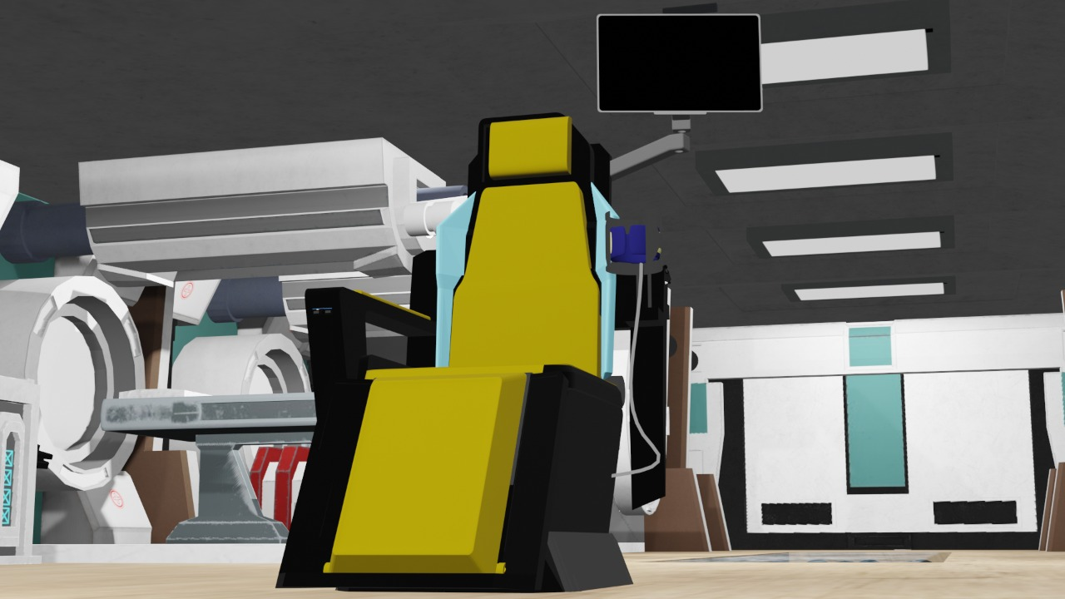
working
This machine is used to test or measure the blood pressure, rate of heart beat, weight and sugar.

Slide 4

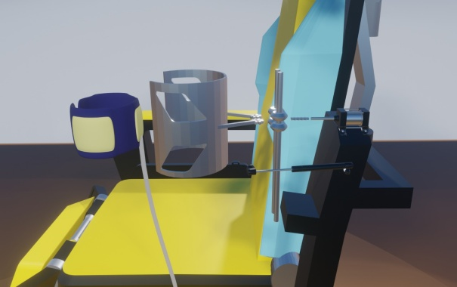
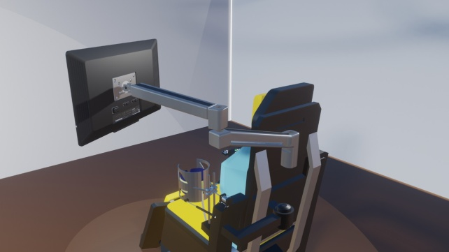
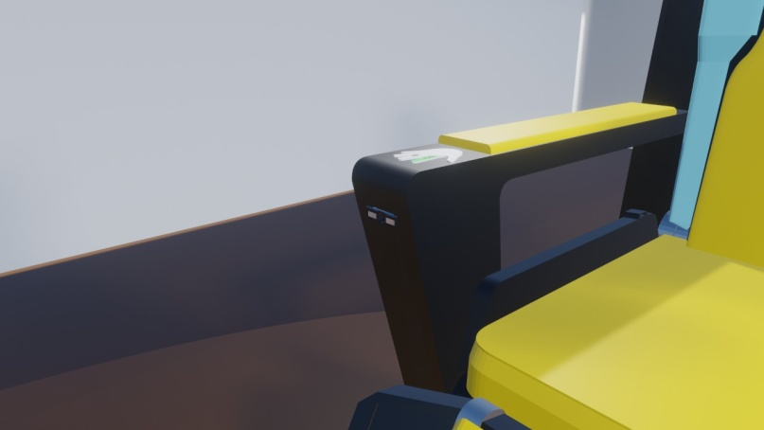
Entire system
Automatic LCD display
Blood pressure detector
Sugar and heart
rate detector

Slide 5

Applications
It is also used to calculate the weight automatically by the help of the weight sensor
Blood pressure is automatically carried out without any man power.
Heart rate is measured using heart rate sensor.
It is also used to measure the blood sugar level.

Slide 6

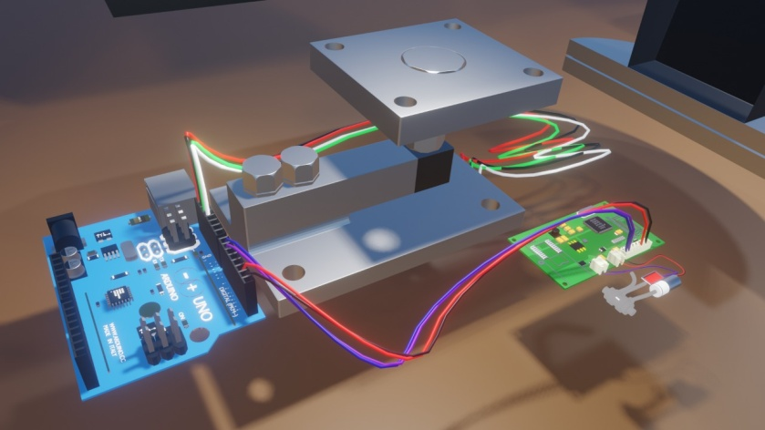
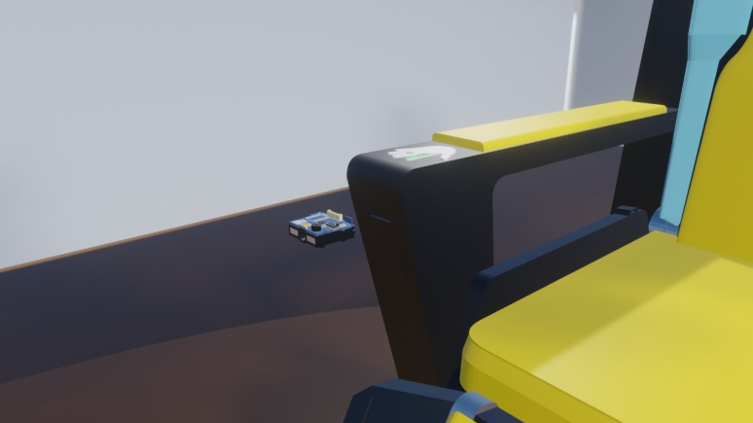
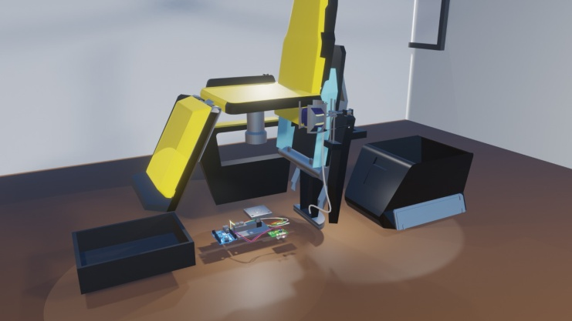
Blood pressure machine
Weight machine
Bar code scanner
Base circuit carrier

Slide 7
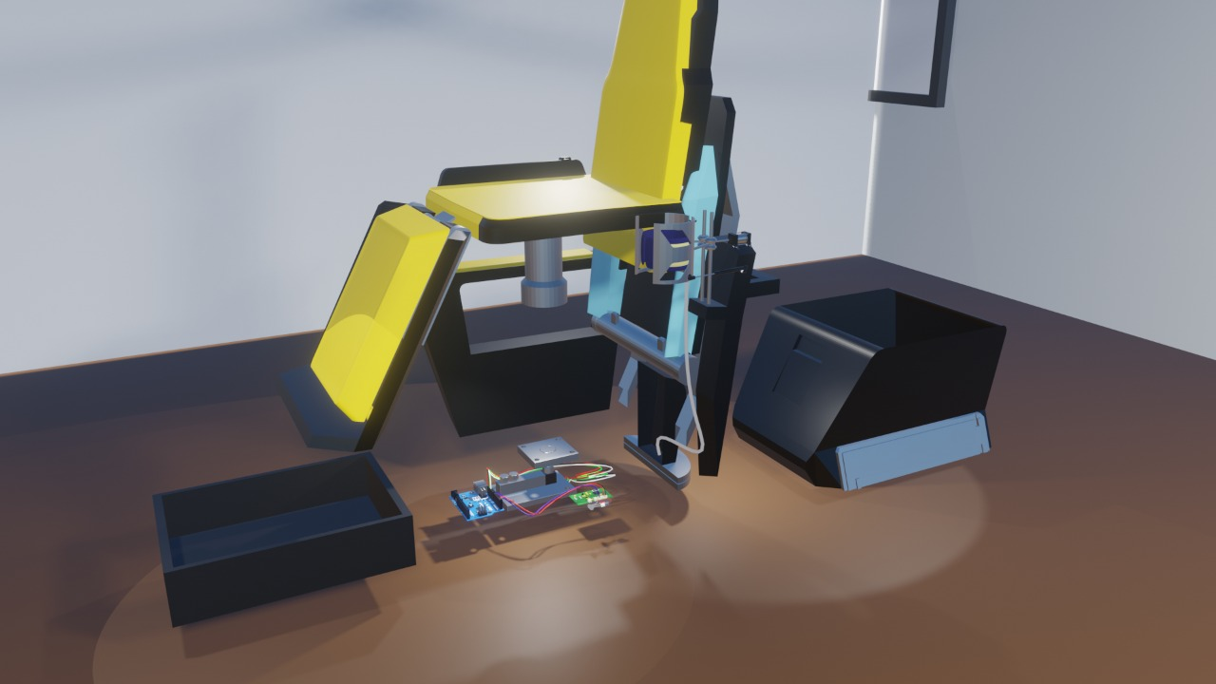
Base circuit carrier

Slide 8

Auto weight machine

Slide 9

Auto Blood pressure detector

Slide 10
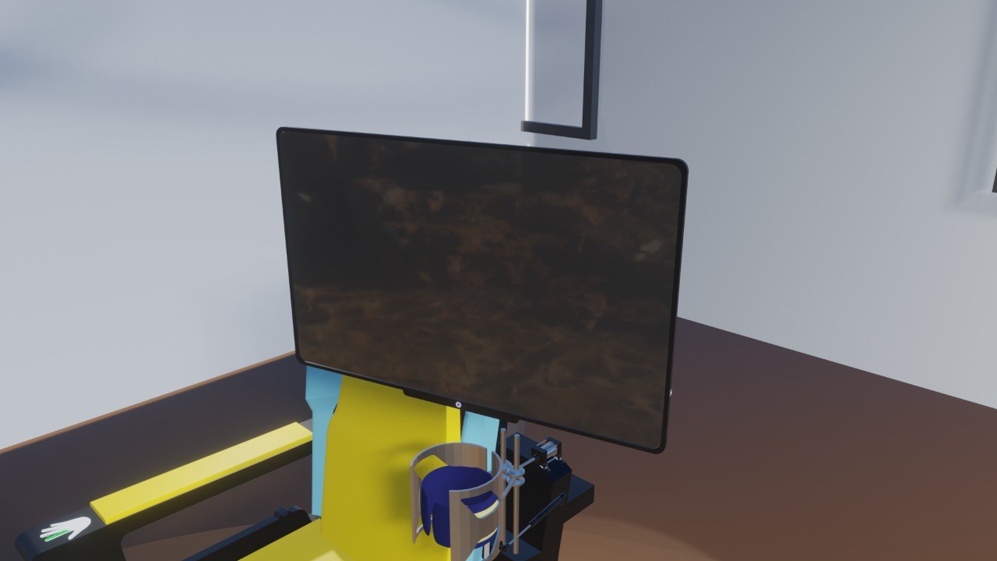
Auto display LCD monitor screen

Slide 11

Barcode sensor

Slide 12
Merits:
1
3
It is specially made for aged people.
2
Multiple works are done in a fraction of minutes.
Time consumption is very low.

